Slide 1



Analysis of the
Economic Impact and
Return on Investment of Education
The economic value of the San Diego Community College District

Slide 2
ADVISORS IN LABOR MARKET INFORMATION
Years working with community colleges
Of U.S. community colleges have used Emsi’s economic impact studies
Students used Emsi’s career
pathways tools last year
2017 Aspen Prize finalists are Emsi customers
Notes:
We have completed over 1,700 EIS across US, UK, and Canada (with over 83% done for US clients)

Slide 3

What is an
economic impact analysis?
Measures how an event or institution affects the local economy.
What is an
investment analysis?
A comparison of the costs and benefits to determine the return on investment.

Slide 4
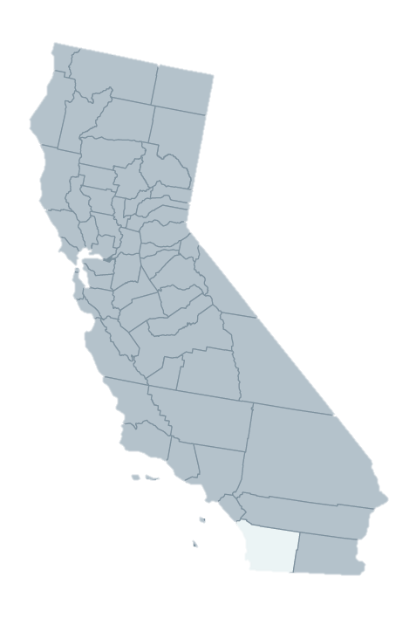
Average earnings by education level
at career midpoint
Total gross
regional product (GRP)
Total jobs

Slide 5
The SDCCD in FY 2017-18
credit students served
Non-credit students served
Employees
Total Payroll/Benefits
students from outside
the County
Total tuition revenue

Slide 6
OVERVIEW OF RESULTS
total income Added
in the County
Total Jobs supported in the County
Rate of return to students
Rate of return to taxpayers
of County’s GRP

Slide 7
Operations
Spending Impact
Student
Spending Impact
Alumni
Impact
College payroll and other spending + ripple effects
Relocated/Retained student spending + ripple effects
Higher alumni earnings
and increased business profit
+ ripple effects
added county
income
added county
income
added county
income
or
or
or
Jobs supported
in the county
Jobs supported
in the county
Jobs supported
in the county
All results measured in income, not sales.
Results are net of counterfactual scenarios.

Slide 8
Total Impact
Impacts by industry
Total INCOME added
IN THE county
or
OF COUNTY’S GRP
Total JOBS SUPPORTED IN THE county
or
1 out of every
Jobs in THE county

Slide 9
Student
Perspective
Taxpayer
Perspective
Social
Perspective
Benefit: Higher future
earnings
Benefit: Future tax revenue,
government savings
Benefit: Future earnings, tax revenue, private savings
Cost: Tuition, supplies, opportunity cost
Cost: State and
local funding
Cost: Student and
all college costs
Benefit/Cost ratio
Benefit/Cost ratio
Benefit/Cost ratio
Rate of return
Rate of return
Rate of return
Future benefits are discounted to the present.

Slide 10
Next Steps
Send the executive summary to local legislators.
Use social media to broadcast student returns to prospective students and parents.
Share industry impacts with local business partners.
Leverage impacts for proposals, grant writing, & strategic planning.
Use campus fliers, newsletters, & websites to publish results.
Share results with local media.
How can
Emsi help?
Emsi’s Press Packet
Ongoing presentations from your Emsi economist
Email/call us anytime

Slide 11
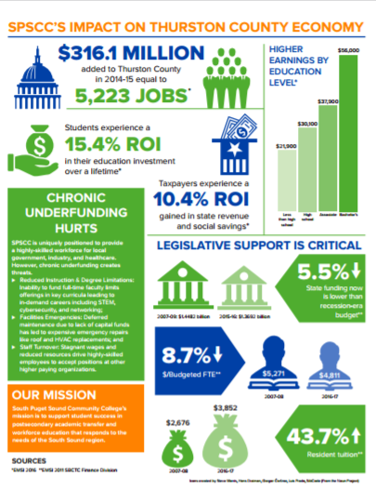

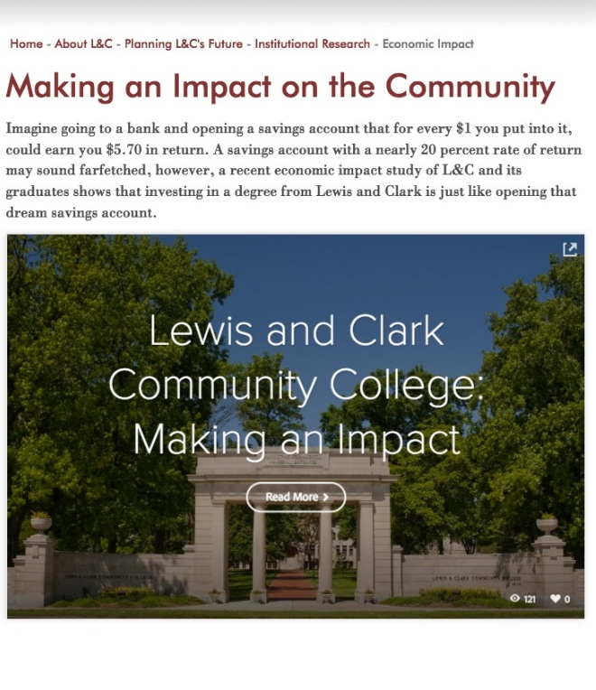

Share Your Results
Combine your results with other institutional highlights to create a fact sheet.
Include your results in your periodic publications.
Create a web page that includes written highlights, animations, and videos.

Slide 12
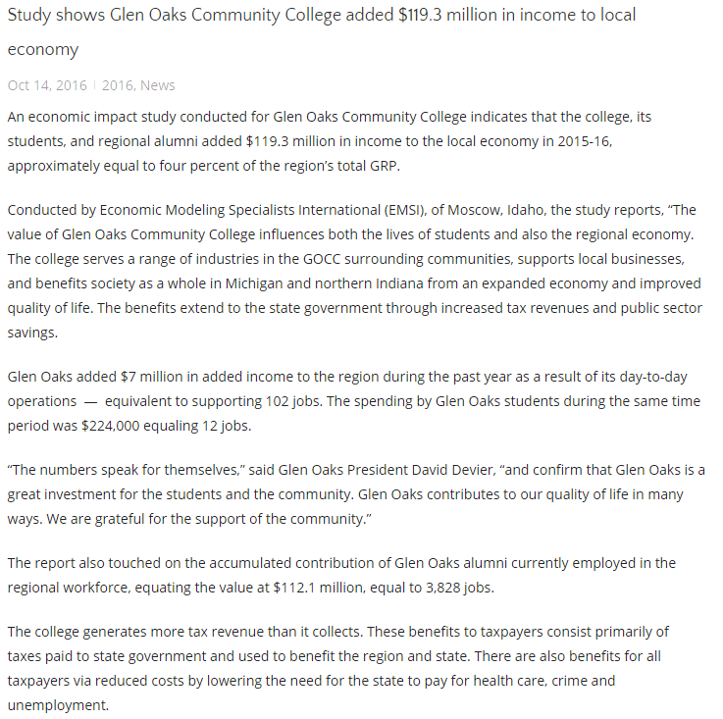
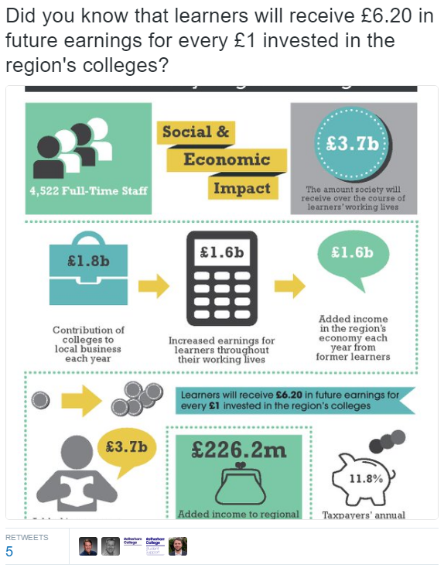
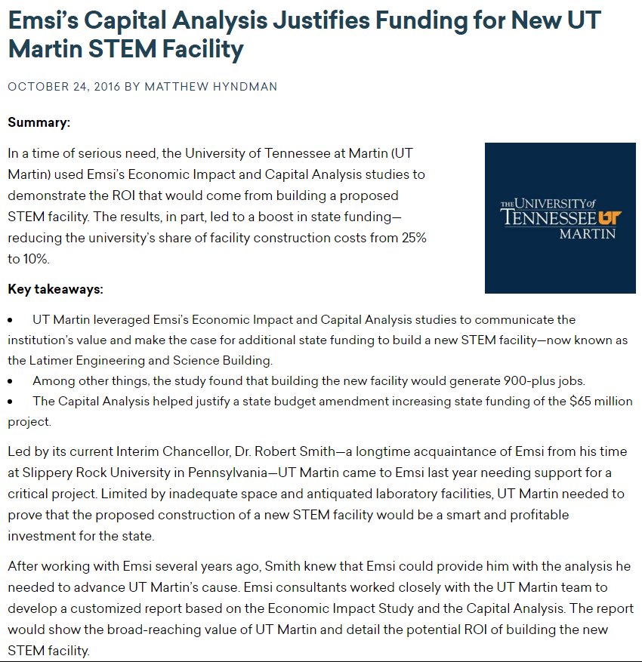
Share Your Results
Create a press release and share with your state and local media.
Use social media to share your investment results with prospective students.
Use your study to help secure additional funding.

Slide 13

The results of this study were prepared by
For a copy of the report, please contact the District.

