Slide 1

Flexible Spending Accounts & My SmartCare
2027 Plan Year
Cris Lovins | National Account Executive
BCC | 858-649-7003
clovins@bccbenefitsolutions.com
Notes:
Audience can be:
Broker
Brokerage Firm
Prospect/Client w/broker in attendance

Slide 2




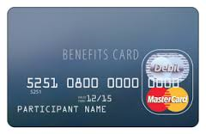
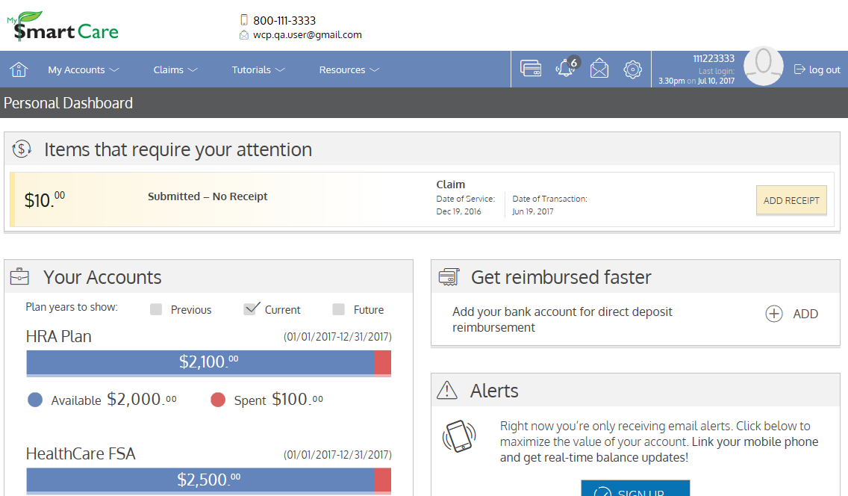
Your FSA options and tools
Health Care FSA
Dependent Care FSA
Transportation & Parking Reimbursement
Debit Card
Web Portal
Mobile App

Slide 3
How FSAs work
Set aside pre-tax dollars for eligible health care or dependent care expenses.
Contributions come from payroll before taxes; typical savings are 23%–33% of contributions.
Health Care FSA — covers eligible expenses for you and qualifying dependents.
Dependent Care FSA — covers work-related care for a child under 13 or a dependent unable to care for themselves.
Notes:
Corporate Overview
Part of a group of benefits related companies
Commonly owned
Each provide different services; but all complementary of each other
All created to solve for specific needs in the industry
Been around a long time
Could have all of these services from all of these companies
You can come to one single source and we have integration with each other

Slide 4
FSA rules to remember
Re-enroll every year during open enrollment.
Expenses must be incurred (received) during your coverage period.
Change elections only after a qualifying event; notify the plan within 31 days.
Budget conservatively—unused funds may be forfeited.
Grace period — 2½ extra months to incur eligible expenses (thru 3/15/2028). Health Care FSA and Dependent Care FSA
Runout period — 3 months after year-end to submit claims (thru 3/31/2028).

Slide 5
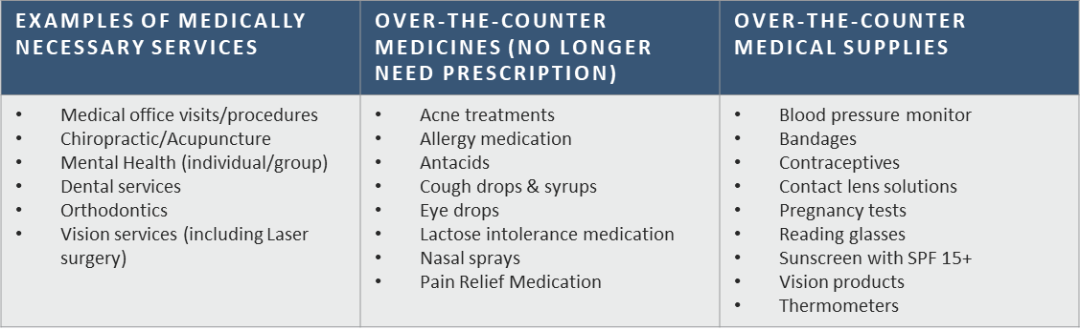
Health Care FSA: what it covers
Use funds for eligible expenses for you and your dependents—even if health coverage is placed elsewhere.
Common expenses include copays, deductibles, prescriptions, dental, vision, OTC items and medical supplies.
2027 contribution limit
$3,400
Not eligible: insurance premiums, teeth whitening, cosmetic treatments and couples counseling.
Notes:
Corporate Overview
Part of a group of benefits related companies
Commonly owned
Each provide different services; but all complementary of each other
All created to solve for specific needs in the industry
Been around a long time
Could have all of these services from all of these companies
You can come to one single source and we have integration with each other

Slide 6
Health Care FSA: key considerations
Elect annually; midyear changes require a qualifying event.
You and your spouse may each enroll through your respective employers.
No double dipping—an expense can be reimbursed only once.
Your annual pledge is deducted evenly through payroll.
The full annual election is available on day one of the plan year.
Grace period — 2½ extra months to incur eligible expenses.
After runout, unused funds are forfeited.

Slide 7
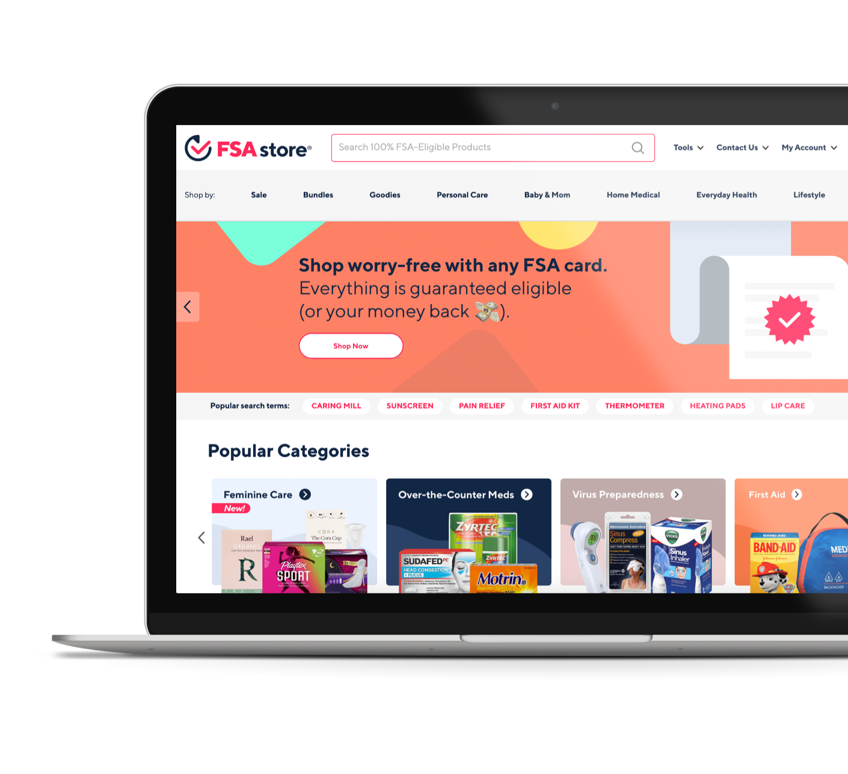
Shop eligible products with FSA Store
BCC partners with FSA Store to make spending FSA dollars easier.
4,000+ eligible products
Exclusive discounts
Free shipping on orders of $50 or more
Clear eligibility guidance
Visit FSA Store to learn more.

Slide 8
Dependent Care FSA: eligible care
Covers care that allows you and your spouse to work.
Eligible dependents — child under 13; incapacitated child or adult living with you; or a child in your custody at least 51% of the time.
Eligible care — in-home care, daycare or preschool, before/after-school care and day camp.
Not eligible — non-work babysitting, K–12 tuition or overnight camp.
2027 household maximum
$7,500
$3,750 if married filing separately
Cannot exceed the lower spouse income
Notes:
Corporate Overview
Part of a group of benefits related companies
Commonly owned
Each provide different services; but all complementary of each other
All created to solve for specific needs in the industry
Been around a long time
Could have all of these services from all of these companies
You can come to one single source and we have integration with each other

Slide 9
Dependent Care FSA: key considerations
Elect annually; combined household contributions cannot exceed $7,500 for 2027.
Midyear changes require a qualifying event.
Contributions are deducted evenly through payroll.
Reimbursement is limited to the current account balance—there is no prefunding.
Your W-2 reflects contributions; report contributions and the provider tax ID on your federal return.
Grace period — incur 2027 expenses through 3/15/2028.
Runout period — submit 2027 expenses through 3/31/2028.
No rollover—remaining funds are forfeited.
The IRS does offer a tax credit for dependent care expenses. Generally a larger savings occurs when participating in a Dependent Care FSA. Some may be able to do both. Consult with your tax advisor for guidance specific to your situation.

Slide 10
Transportation reimbursement
Eligible Commuter Expenses
  Transit Pass
  Transit Token
  Transit Fare-Care
  Transit Voucher
  Van-Pooling
  Commuter High Vehicle Expenses
Expenses must be provided by a Mass Transit Facility
Maximum contribution per month is $340

Slide 11
Parking reimbursement
Eligible Parking Expenses
  Fees for parking located on or near employer’s premises
  Fees for parking at or near mass transit (allow to commute via mass transit)
  Fees for parking at or near a van/carpooling location
  Parking provided to you where your employer pays directly to a parking lot operator
  Parking that an employer provides on its premises that requires a lease
Maximum contribution per month is $340

Slide 12
Transportation & parking
Expenses not eligible:
  EZ Pass
  Highway Tolls
Additional information on transportation & parking reimbursement:
  Two separate accounts (cannot co-mingle funds)
  Enroll at any time during year as well as make changes: increase, decrease, cease
  May submit claims for reimbursement if vendor does not have proper MCC code for debit card use
  Documentation rules apply (no cancelled checks, need itemized receipt identifying date of service and amount)
  Funds may rollover to the next year, if re enroll

Slide 13
Using your FSA debit card
One card covers all enrolled FSA accounts.
Swipe at eligible merchants and choose “credit”—no PIN is needed.
A replacement card is issued when the current card expires, not every year.
Most transactions are verified electronically.
Keep receipts in case BCC requests documentation.
Respond promptly to substantiation requests to avoid card suspension.

Slide 14
Why keep debit card receipts?
The IRS requires every claim to be substantiated.
Most debit card transactions are verified automatically.
If BCC requests documentation, submit it promptly.
Unresolved charges may be treated as overpayments and card access may be suspended.

Slide 15
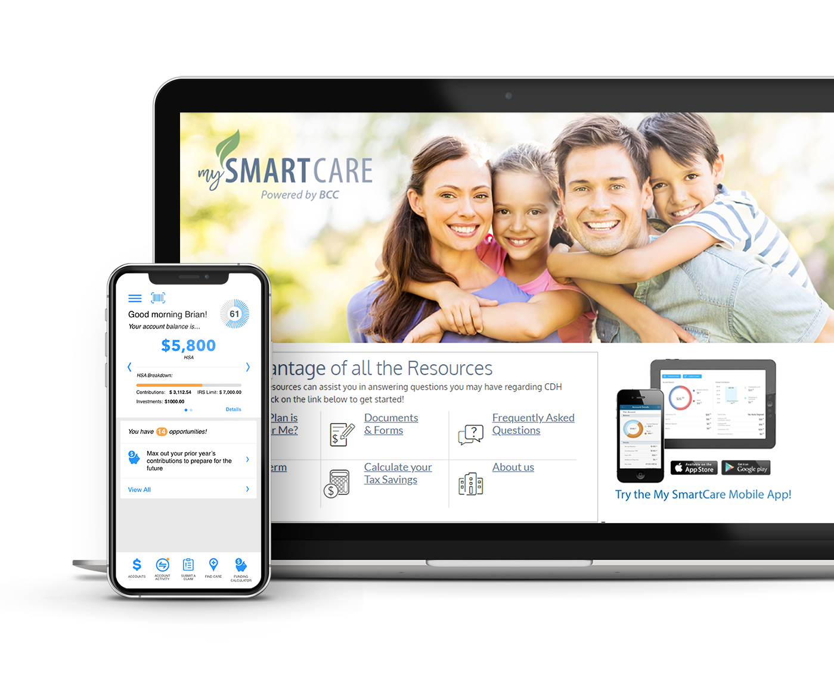

One card. One account. One app.
Manage FSAs, DCAs and HSAs through one connected experience.

Slide 16
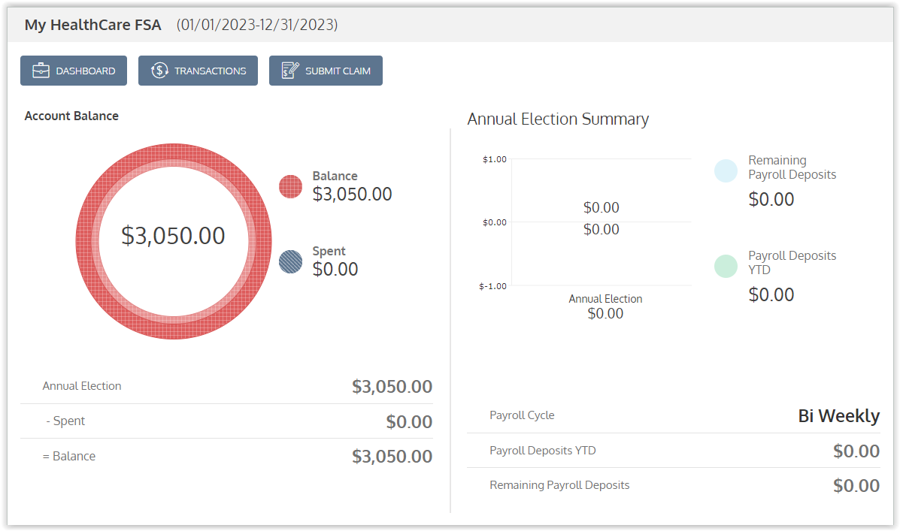
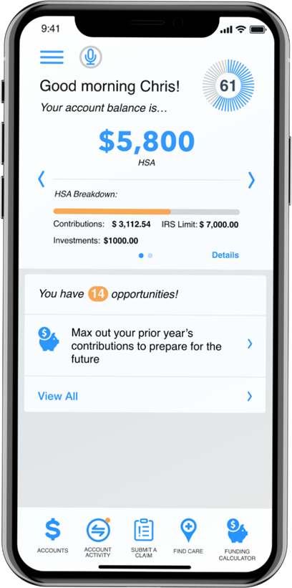
My SmartCare in one place
One login for the portal and app
Real-time balances and claim status
Electronic claims and document upload
Transaction history and statements
Lost or stolen card reporting
Alerts, forms, FAQs and calculators

Slide 17
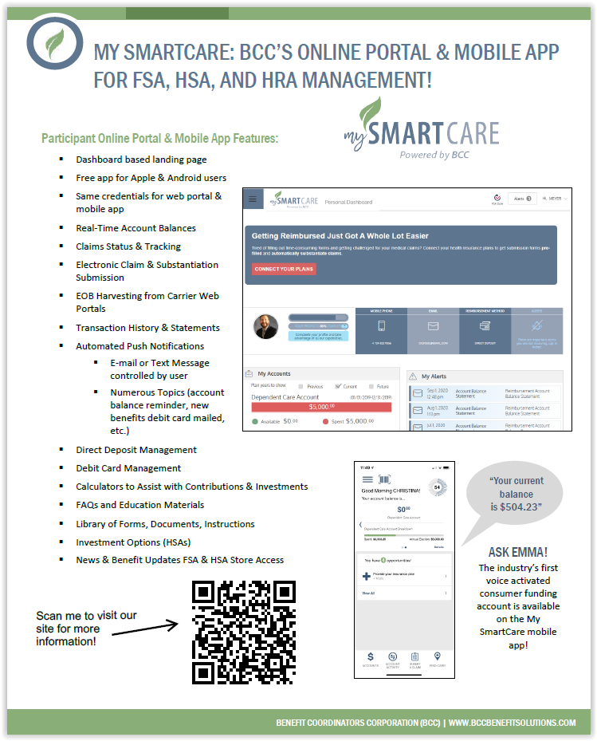
My SmartCare portal at a glance

Slide 18
Submitting a manual claim
Submit a claim when:
  The merchant does not accept the card.
  The purchase exceeds your available balance.
  The card is unavailable—or you prefer not to use it.
  A dependent care provider cannot accept the card.
How to submit:
  Send the reimbursement form and documentation through the portal or app, or by email, fax or mail.
  Reimbursements are processed weekly by direct deposit or check; direct deposit is fastest.

Slide 19
Dependent Care FSA: paying for care
Common challenges:
  Some providers do not accept cards or use an eligible merchant code.
  Funds are not preloaded, so the available balance may not cover the full charge.
When reimbursement may work better:
  Submit a claim for the full monthly care cost, ideally at the start of each month.
  After submitted claims meet or exceed your annual election, no further claims are needed; the plan pays as new contributions become available.
  Enroll in direct deposit for the fastest payment.

Slide 20
Prepare for open enrollment
Estimate annual medical, dental, vision and dependent care expenses.
Review copays, coinsurance and deductibles.
Confirm planned eyewear or dental work with family members.
Choose a conservative contribution amount.
Submit your 2027 election during open enrollment.
Contributions begin with the first 2027 paycheck.
After enrollment, changes require a qualifying event.

Slide 21

Questions?
Resources
  bccbenefitsolutions.com
  Follow BCC on LinkedIn
Customer service
  Mon–Thu: 5:00 a.m.–5:00 p.m. PT
  Fri: 5:00 a.m.–3:00 p.m. PT
  800-685-6100
  Member portal: benefitcc.wealthcareportal.com/Page/Home

Slide 22
Plan-specific questions
For questions about eligibility, qualified expenses, dependents, orthodontia or dependent care:
Cris Lovins
National Account Executive, BCC
858-649-7003
clovins@bccbenefitsolutions.com

